Slide 1

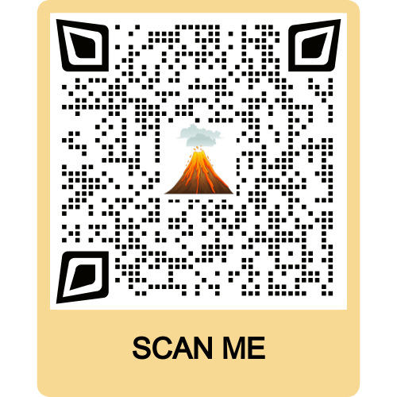

Volcano Eruptions Prediction Model
Students:
Ram Michaeli Gal Israeli Yulia Kuderko

Slide 2

research question
Research question
Can we predict how powerful will the next volcano eruption be?
What pattern can we observe and what conclusions can we learn from them?

Slide 3
Phases
3
Project phases
Data acquisition
Data cleaning
EDA
Machine Learning
Predict volcano type based on volcano height
Predict So2 emission of volcano
Prediction of next eruption strength
Conclusions

Slide 4
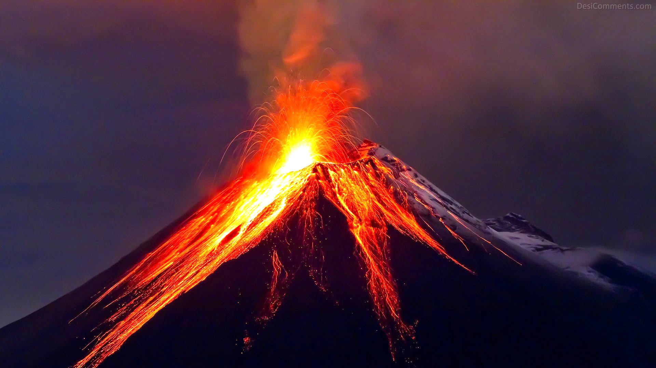
acquisition
data

Slide 5
crawling process
Data cleaning
Crawling
First, we used selenium in order to be able to click on the “submit eruptions” button that would lead us to the main url, which we needed to collect our data from.
We created lists for the features that eventually will be represented by columns in the final data frame.
Then, we used a loop that went through the pages using selenium library. Selenium allowed us to click the "next" button after every time we finished collecting the data from the current page.
We were able to extract all the relevant attributes and instances in each specific page using beautifulSoup library.
Each attribute was added to the lists we created in the beginning of the code.
Eventually, the data was exported to a csv file. This file is required in order to start analyzing our data in Jupyter notebook.

Slide 6
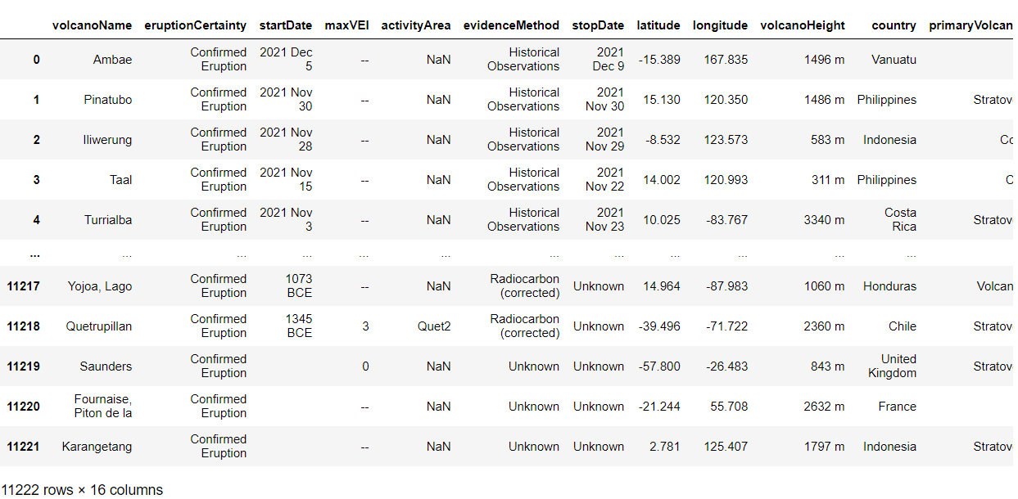
exported data frame
6
Data acquisition

Slide 7
Crawling resources
7
Data acquisition
Website that was used for the acquisition process
Packages that were used for crawling
BeautifulSoup, Selenium, pandas, requests
Amount of data that was collected (Raw data volume)
179,552 (before cleaning) ; 148,904 (after cleaning)
Smithsonian Institute - National Museum of Natural History
Minor packages: os, re, sys, time, warnings
Volcano name, Eruption certainty, Start date, Max VEI, Evidence method,
The attributes (columns)
Stop date, Latitude, Longitude, Volcano height, Country, Primary volcano
type, Population 5km, Population 10km, Population 30km, Population 100km

Slide 8
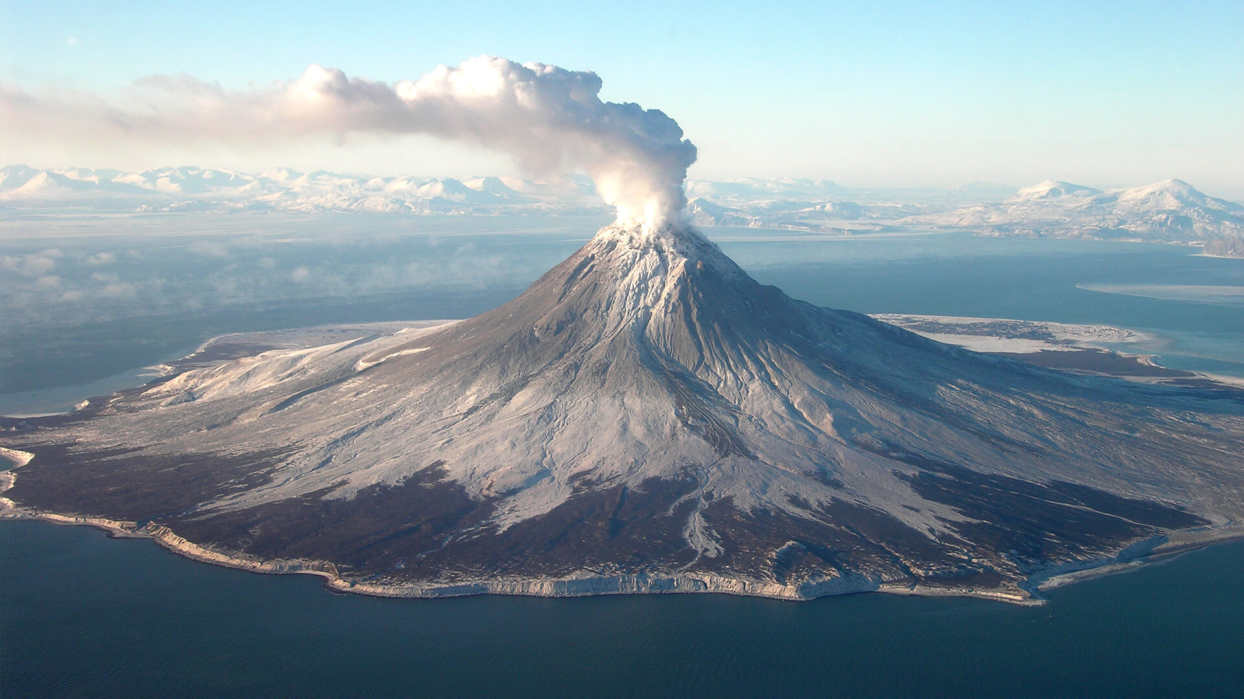
cleaning
data

Slide 9


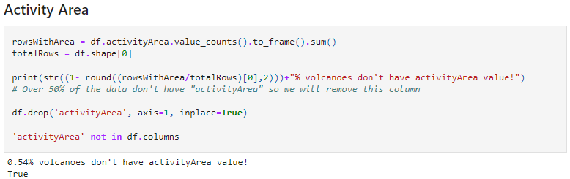
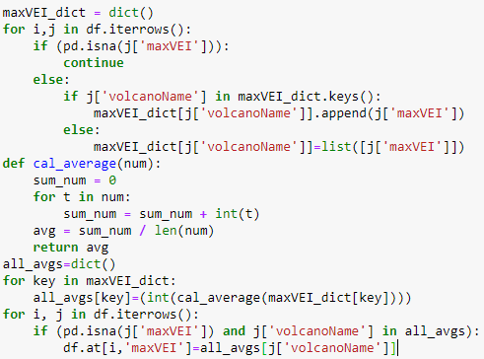
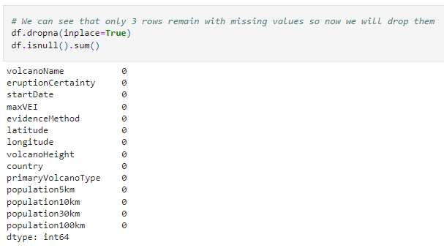
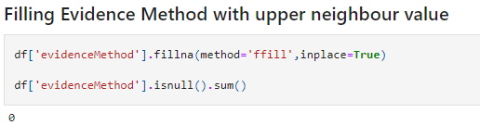
handling missing data
Data cleaning
Filling data (‘Max VEI’ and ‘Evidence Method’)
Dropping null values
Filling Max VEI with mean values. We took each volcano that had several eruptions, calculated their Max VEI averages and added them to the missing cells. Those who had no Max VEI history at all, were dropped completely.
“Activity Area” and “Stop Date” columns ware erased since more than a half of the data was empty. Therefore, these columns are irrelevant.
After taking care of all the cells, we dropped each row that contained missing values using the “dropna” method.
Filling ‘Evidence Method’ with upper neighbor value. We filled each missing cell with its neighbor’s value using the method: “ffill”.

Slide 10
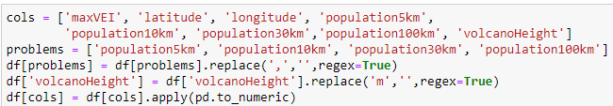
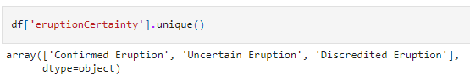
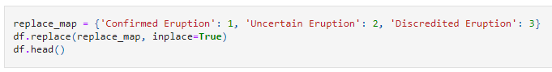
converting types
Data cleaning
Numeric Type
In order to change the ‘population’ columns to numeric values, we had to replace the coma character to an empty character and then we could switch to the desired type.
In addition, we had to replace the “m” letter to an empty character so there wouldn’t be a mix up between numeric characters and strings. After both of these actions, we could easily implement the appropriate type using the “to_numeric” function.
Categorical Type
As we can see, ‘Eruption Certainty’ has only three possible values: confirmed eruption, uncertain eruption and discredited eruption. Therefore, we changed their string values into numeric categorial so that our analyzation in the ML section would be more convenient.

Slide 11
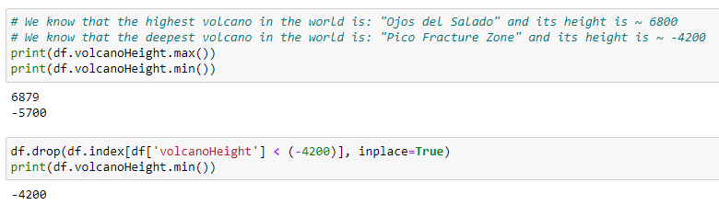
outliers
Data acquisition
Overall, we had almost all our data in its supposed range except for the “volcano height” column.
According to google, the deepest volcano in the world is -4200 meters, so we added the “drop” function in order to eliminate all the volcano heights that exceed this limitation.

Slide 12
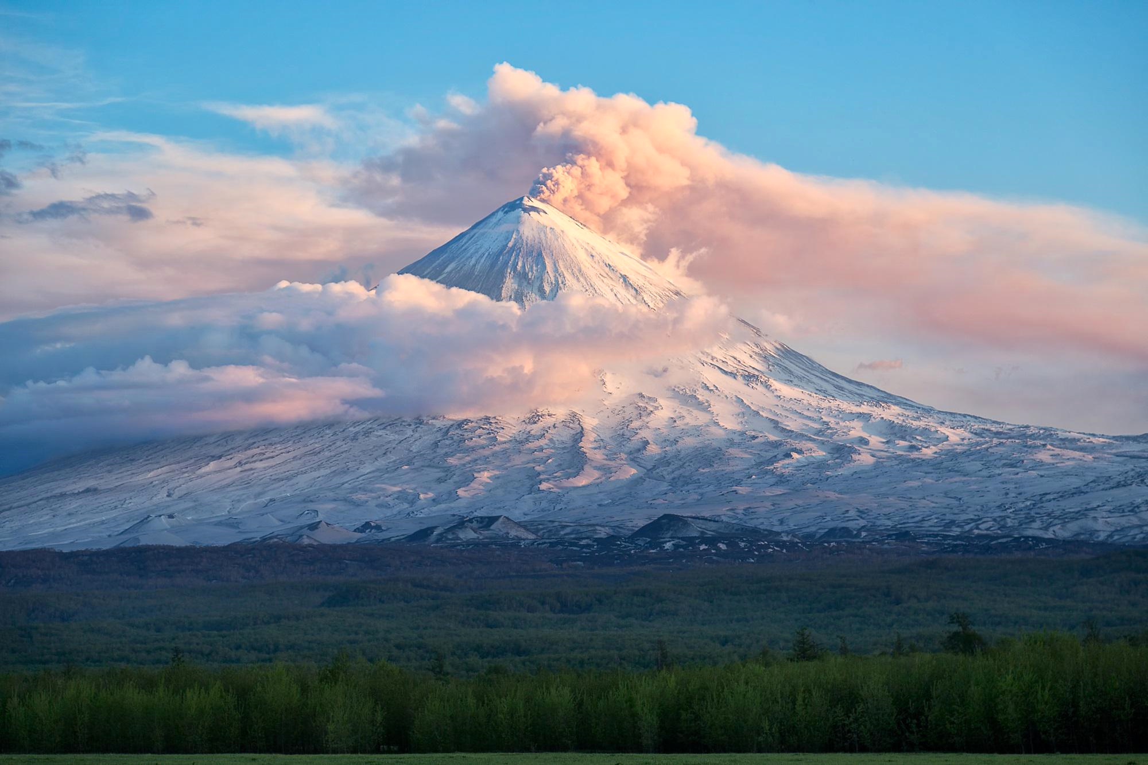
EDA

Slide 13
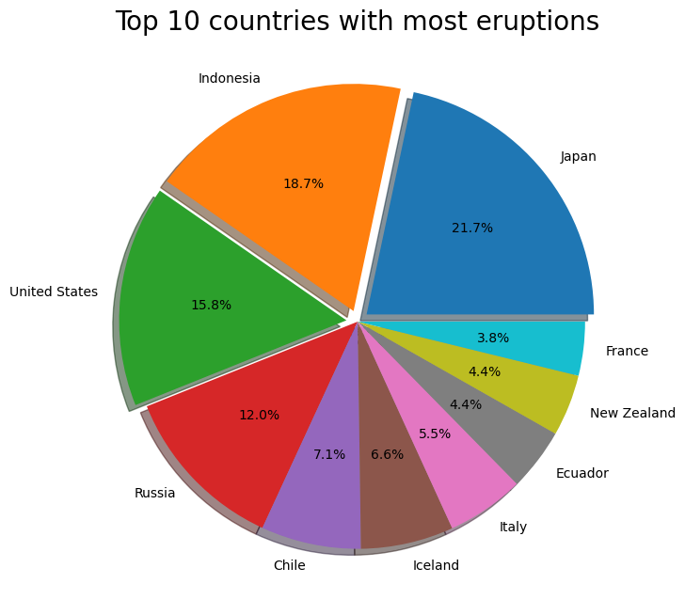
pie chart
13
EDA
Top countries
As we can see, Japan is the country with the biggest number of eruptive volcanoes.
On that note, Indonesia is in the second place and United States takes the third place.

Slide 14
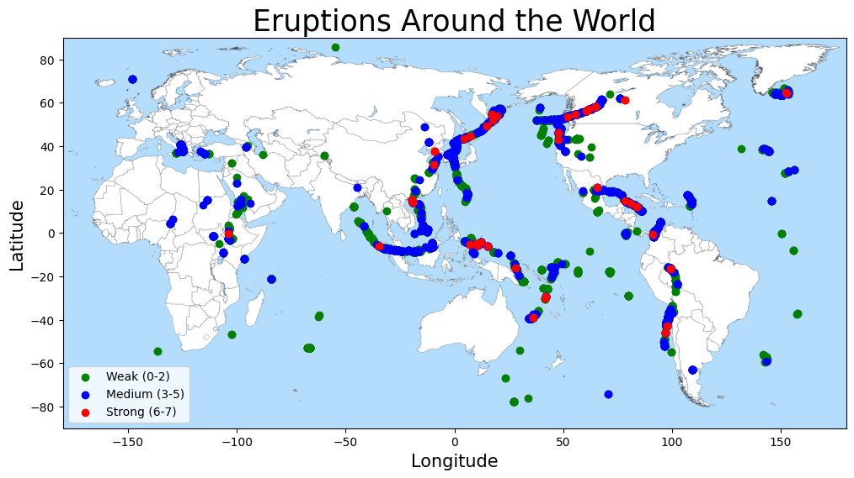
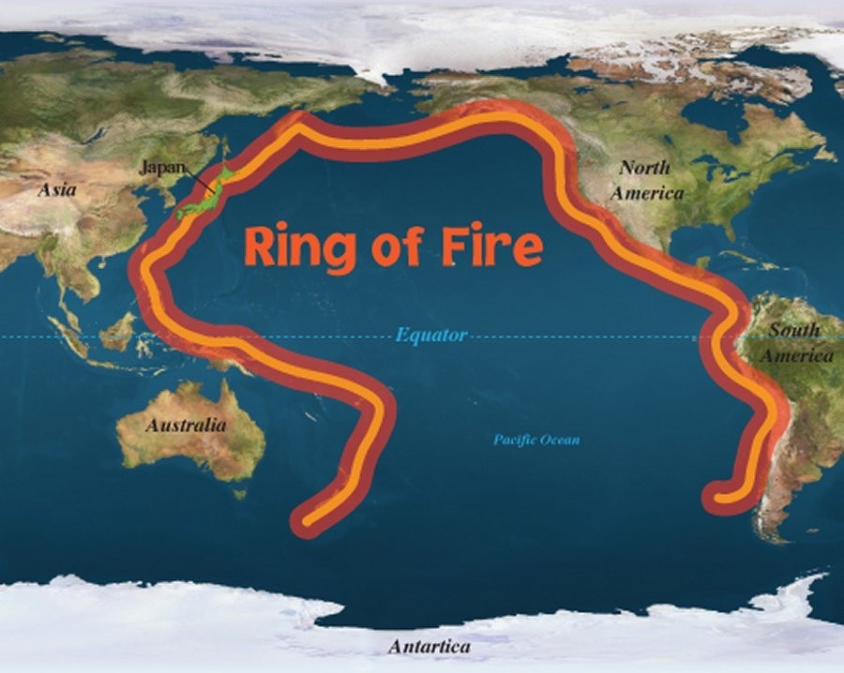
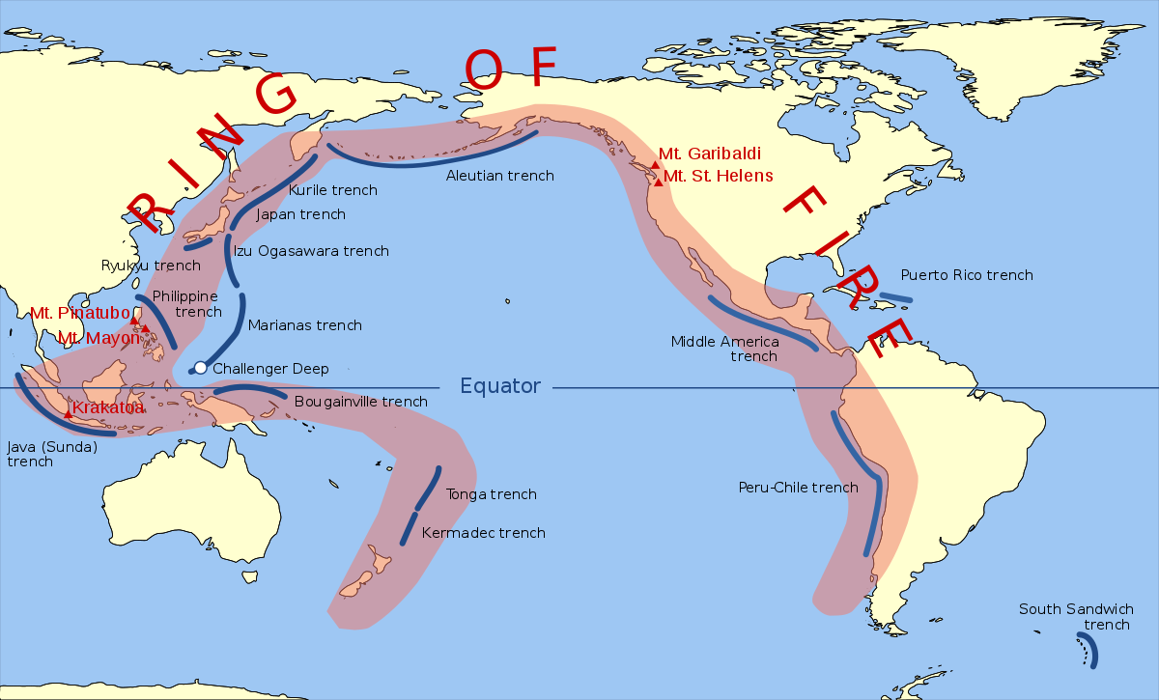
scatter plot
EDA
World Map
These are the locations of the volcanic eruptions. We can see that most of the eruptions indeed occur on the ring of fire as expected.
This is the ring of fire, which is a region where many volcanic eruptions occur.
The ring of fire is surrounded by these continents.
1
1
2
3
3
2

Slide 15
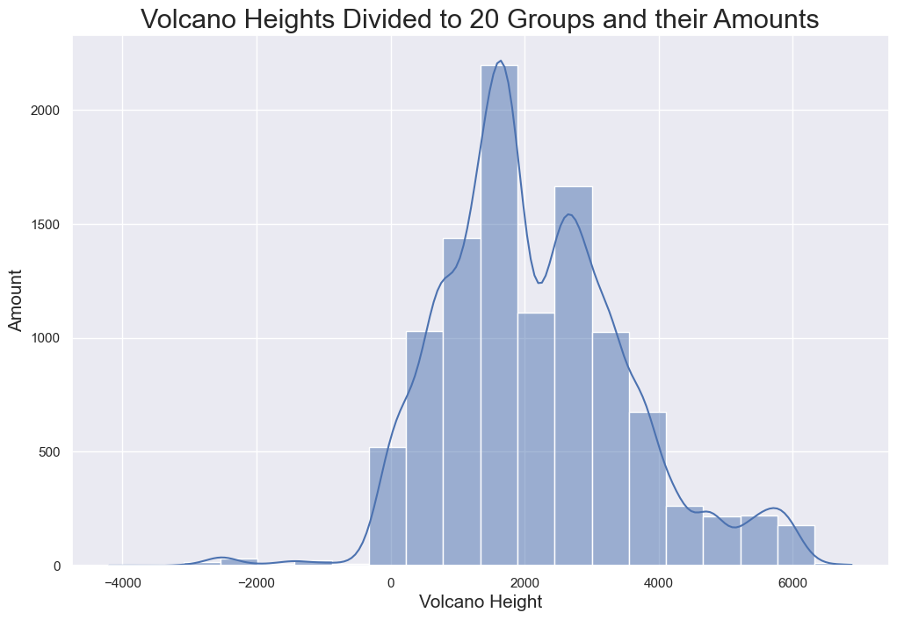
hist plot
EDA
This graph shows a division of volcano heights to 20 groups.
We can see that the most common volcano height is approximately between 1500 and 2000 meter.

Slide 16
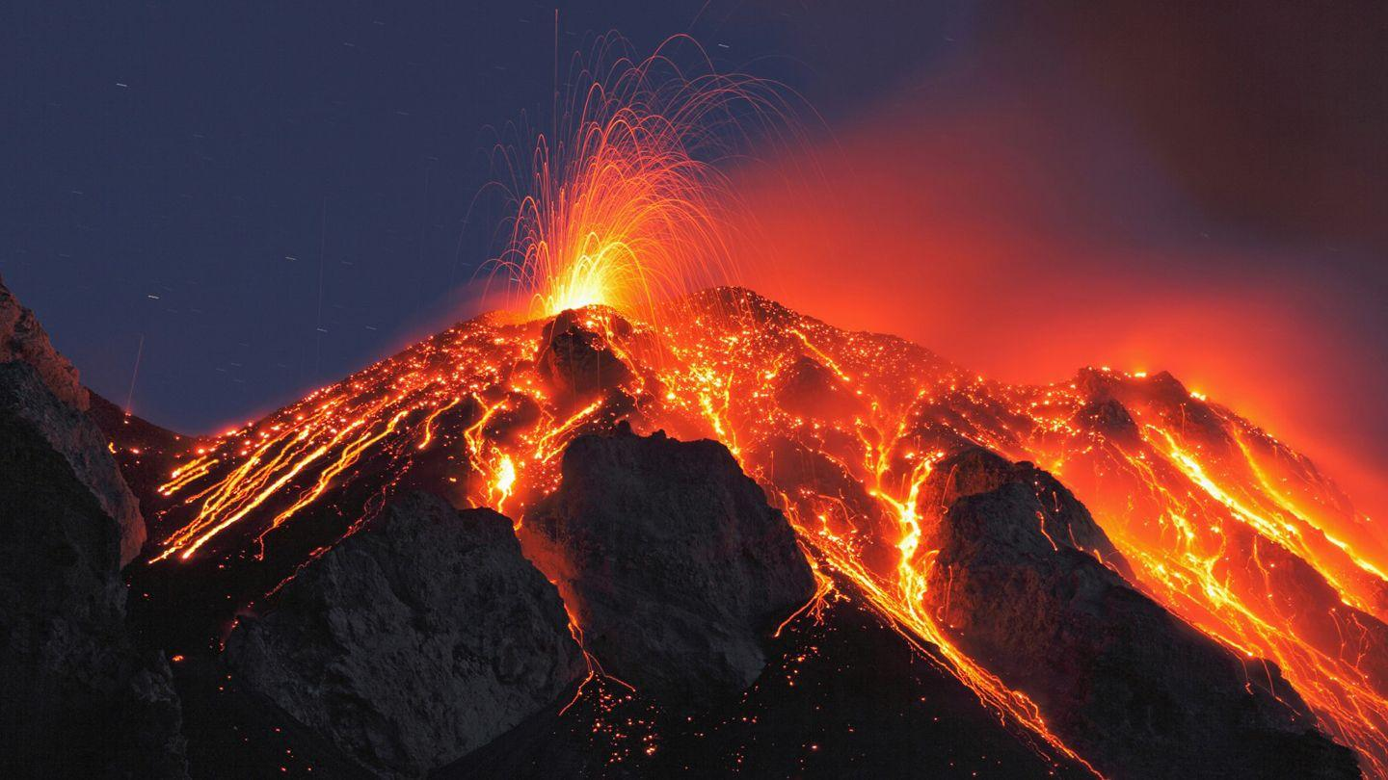
machine
learning

Slide 17
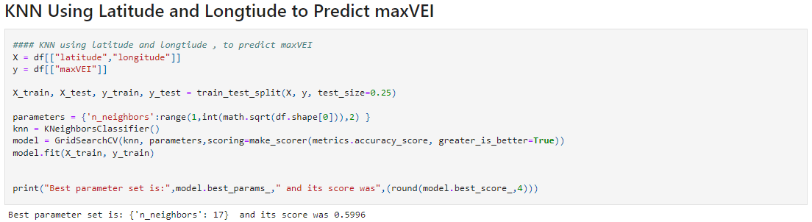
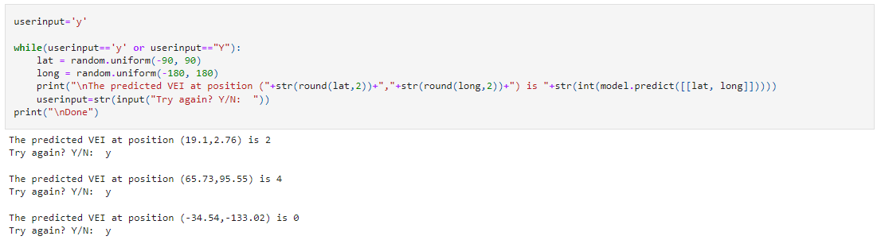
knn
Machine learning
We used KNN because we wanted to predict a categorized result (Max VEI) based on 2 different values (latitude and longitude) and get an answer in range from 0 to 7 (multiple groups). If we get a new instance that we’re not familiar with and we’d like to classify it, the algorithm will divide it into groups that are sorted by the number of some predefined neighbors (K - Hyperparameter).
In KNN, we almost don't train the model at all, but we find the nearest instance available.
We didn’t want to choose a high K value in order not to create an underfitting situation or a very low K value to not create an overfitting.
Therefore, we used Cross-Validation to choose the best K value from a predetermined range (in jumps of 2 so that we could get only odd numbers) until we got a squared root of the instances’ number that are in the train set.

Slide 18
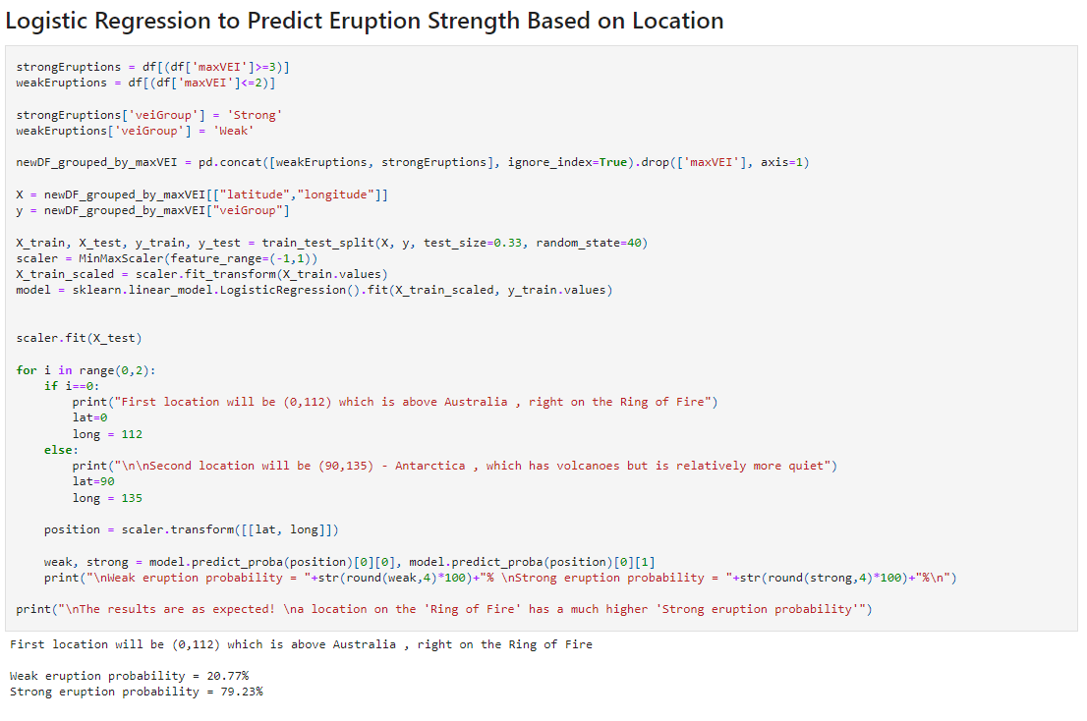
logistic regression
Machine learning
We’ve used this method because it is the best method of predicting belonging to a certain group out of 2 groups.
Another reason of using this specific method is its quality to translate an answer to percent.
We wanted to classify the eruptions into 2 groups: strong eruptions with a value of over 3 in ‘Max VEI’ column and weak eruptions. The model got the “latitude” and “longitude” values from the df, only this time (unlike the previous slide), the result is classification of the eruption to strong and weak. Eventually, the outcome will be the chance of a strong/weak eruption in percentage. Values that are below 50% will be classified as weak and values above 50% will be classified as strong.
In addition, we scaled our data using min-max Normalization (-1 to 1) to create uniform units to all the data.

Slide 19
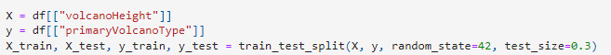
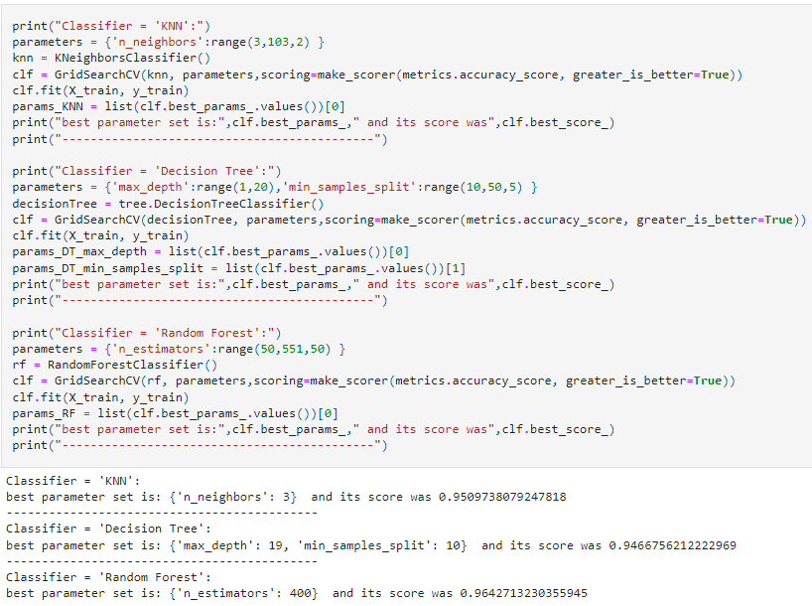
Multiple ml algos
19
Machine learning
In this section of ML, we wanted to check all the tools in our possession and pick the one with the best result.
An explanation on the KKN model was already been made so this time we’ll start with the decision tree.
This method concentrates in asking questions and going deeper in the splitting of the branches until we reach a tree junction that can’t be split (leaf).
In general, this algorithm is looking for the feature that enables it to divide the data into several groups.
Two hyperparameters in this method are: max_depth and min_samples_split .
max_depth is the maximum depth of the tree. If this is not set, then nodes are expanded until all leaves are pure or until all leaves contain less than min_samples_split samples.
min_samples_split is the minimum number of samples required to split an internal node.

Slide 20
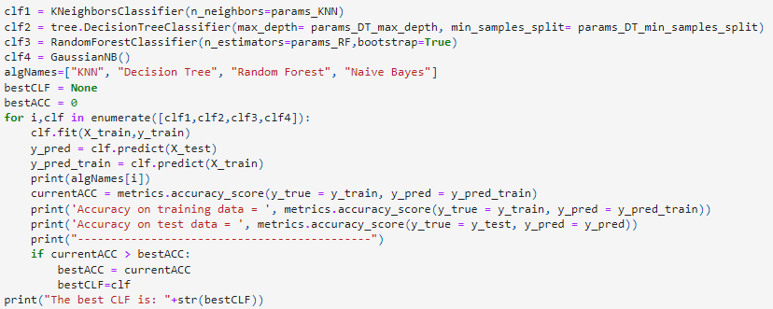
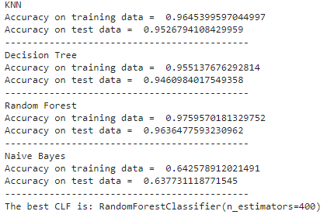
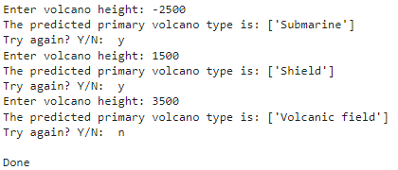
Multiple ml algos
20
Machine learning
The last algorithm we used is “Random Forest”. This method uses multiple algorithms at the same time and then come to a consensus of a predictive label.
The idea behind it is to generate several trained models (e.g., decision tree) based on subsets of the data and let the decision trees vote to arrive at a prediction.
Random forests combine multiple decision trees that were generated with some randomness and let them vote on the result.
Since averaging a set of observations reduces variance, this increases the predictive accuracy of the method.

Slide 21
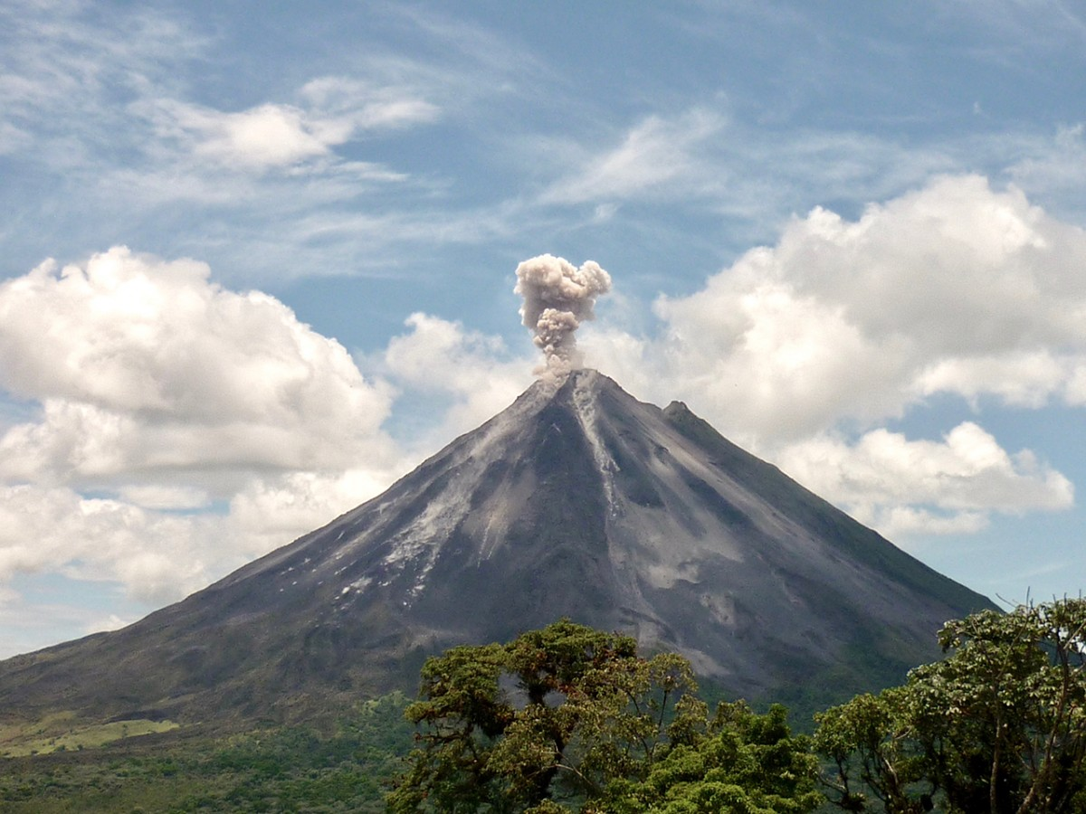
EFFECT
WOW

Slide 22
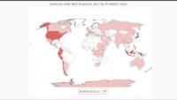
Wow Effect
Wow effect
We have created an interactive map using python libraries that we found online. All the countries that had volcanic eruptions are colored in a way that the more eruptions it had, the darker its country color. Furthermore, the map reacts to the computer mouse's movements, when the curser is on top of a country, it shows the number of eruptions that occurred in it. The code was exported to an SVG file that enabled the creation of this map.

Slide 23
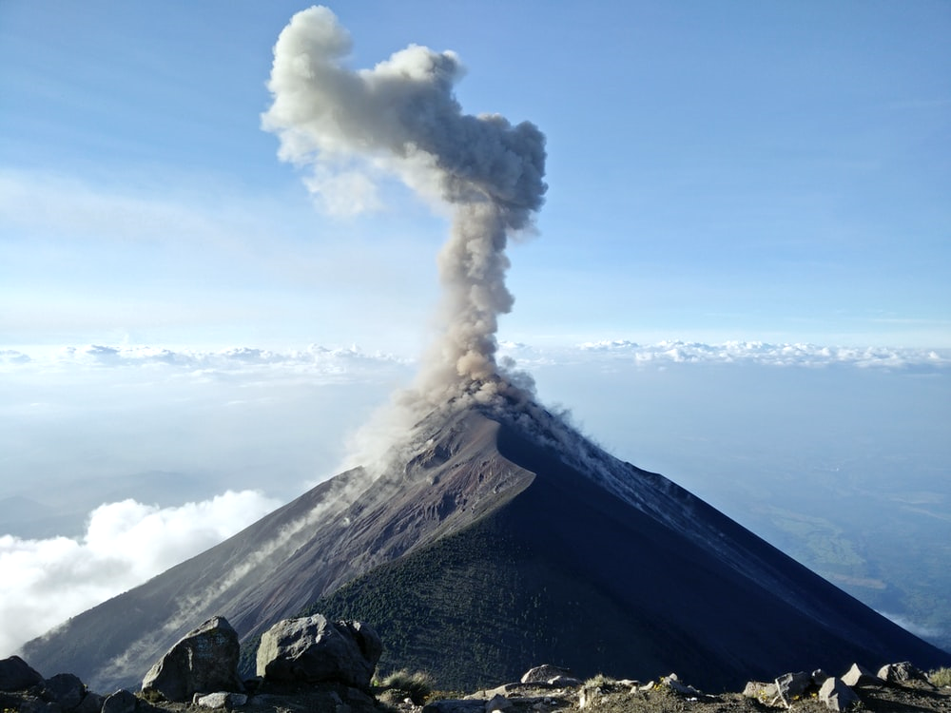
conclusions

Slide 24
conclusions
Conclusions
Conclusions
We have learned a lot about volcanic eruptions. Observing and plotting the data teached us many interesting things, for example, that Japan is the leading country when it comes to eruptions amount. In addition, we learned how powerful machine learning can be, and how useful it can be when trying to find patterns in the data. We were able to predict the strength of the next eruption, as well as predicting volcano types based on their heights and their SO2 emissions.

Slide 25
25
Thank you
Thank You !

